Slide 1
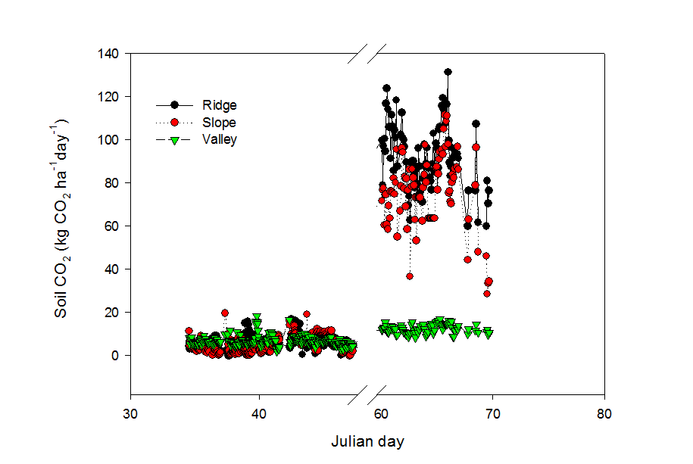
Soil CO₂ flux during 02/03-02/16 and 03/01-03/10/2015

Slide 2
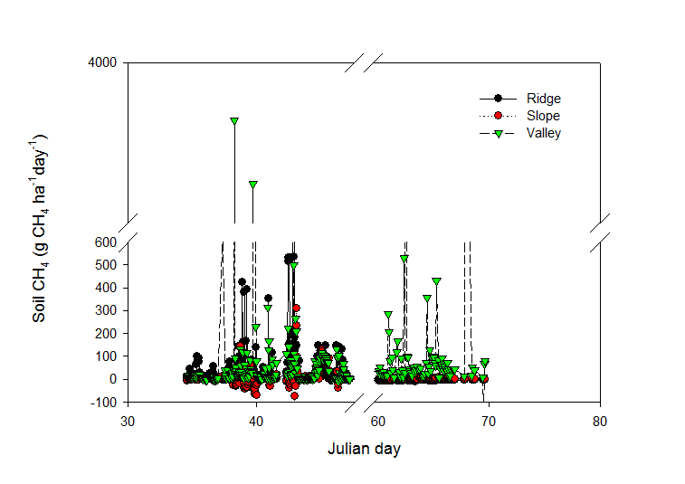
Soil CH₄ flux during 02/03-02/16 and 03/01-03/10/2015

Slide 3
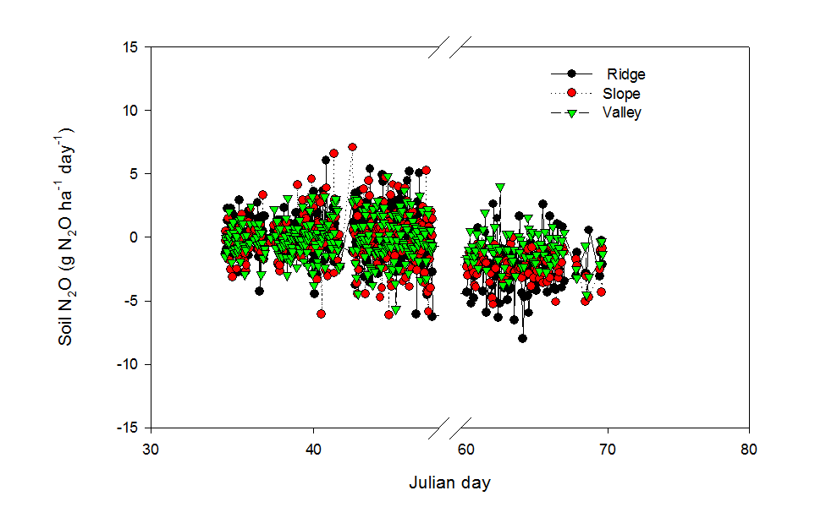
Soil N₂O flux during 02/03-02/16 and 03/01-03/10/2015

Slide 4
Comparison of fluxes in Feb and March individually

Slide 5
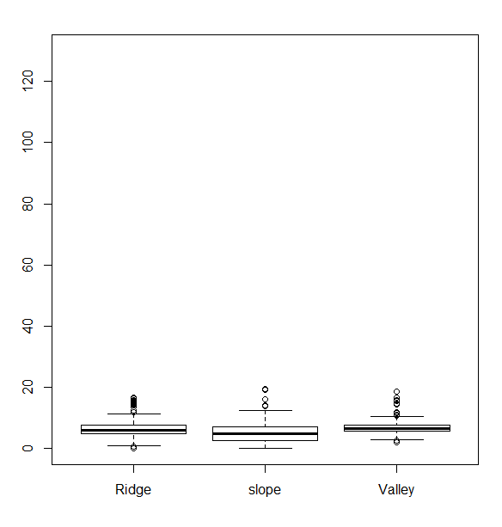
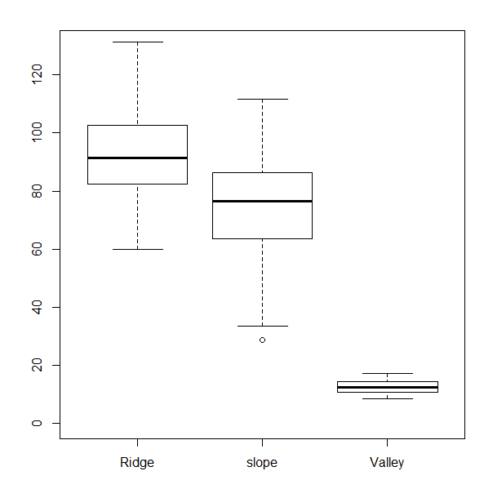
Soil CO₂ flux
February
March

Slide 6
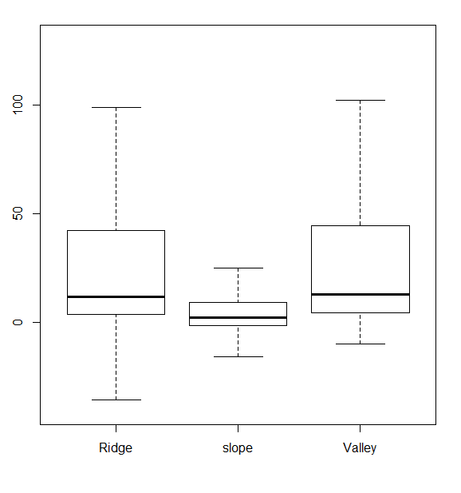
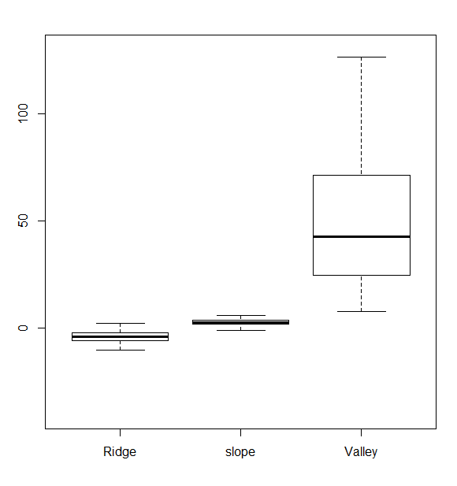
Soil CH₄ flux
>120 g CH₄ ha⁻¹ d⁻¹ omitted for clarity
February
March

Slide 7
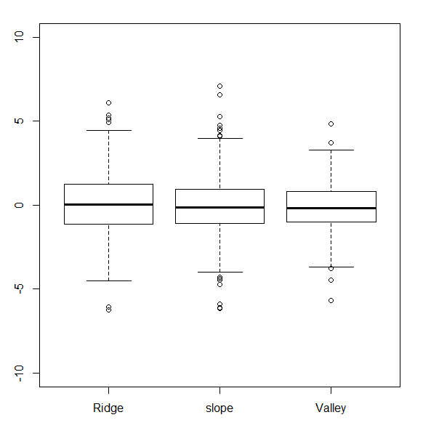
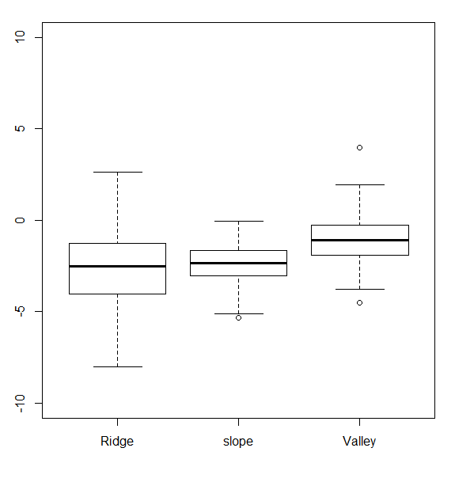
Soil N₂O flux
February
March

Slide 8
Comparison of gas flux with two month data together

Slide 9
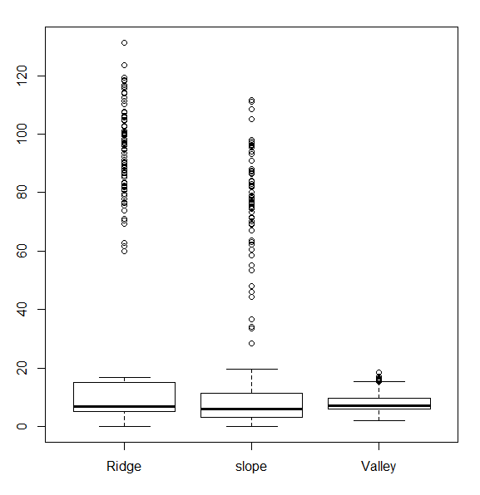
CO2

Slide 10
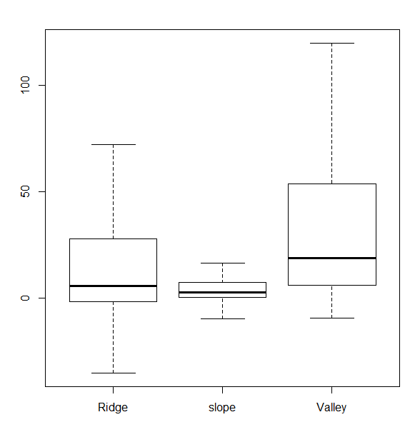
CH4

Slide 11
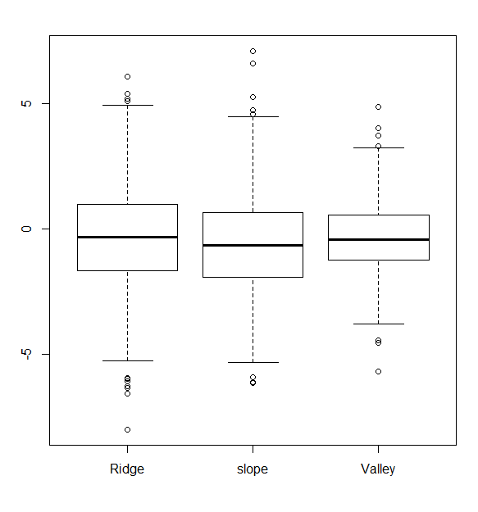
N2O

